Slide 1
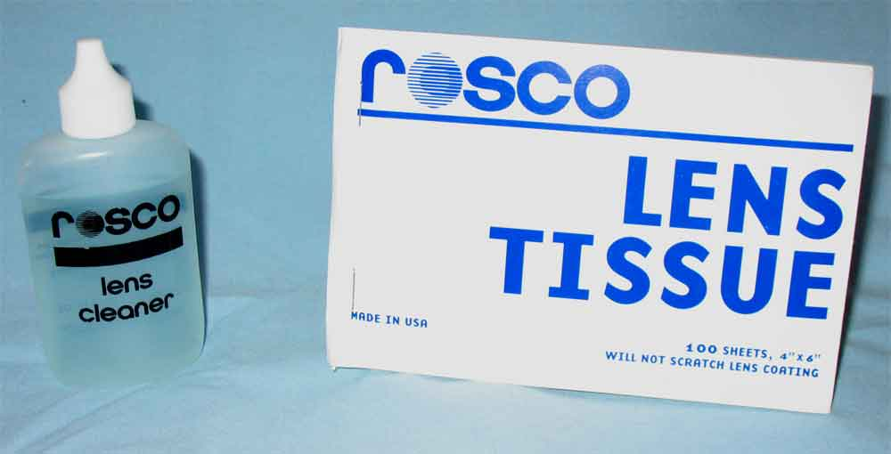
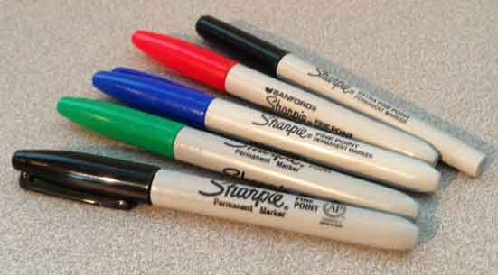
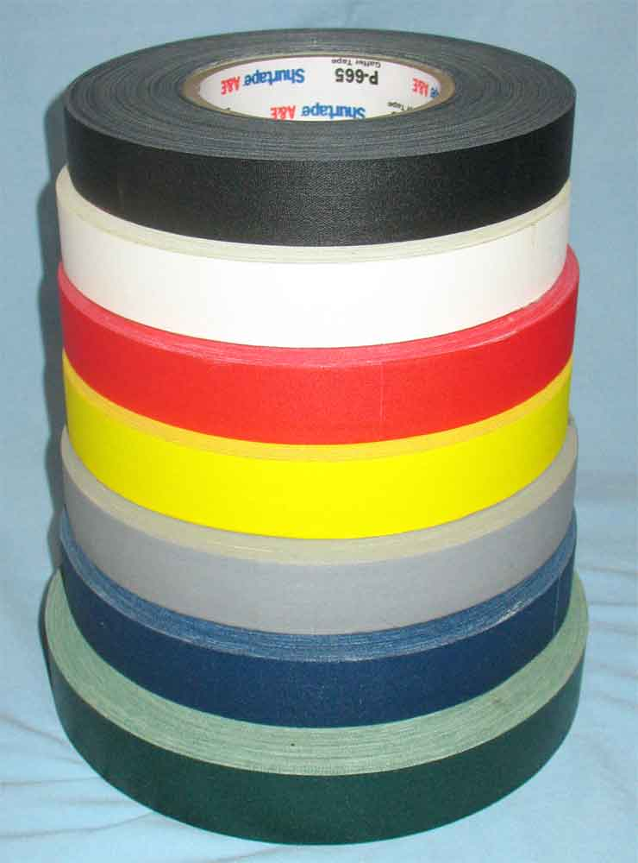
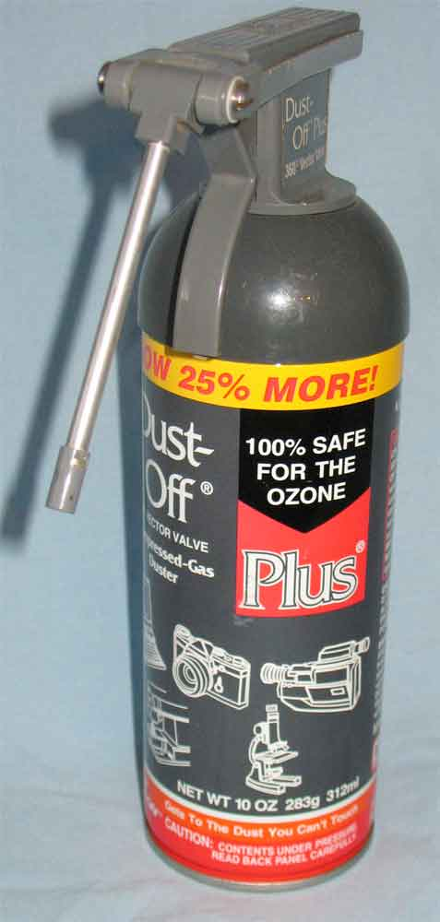
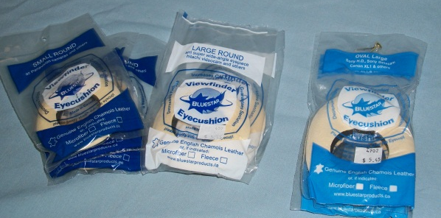
Expendables

Slide 2
The following shows many of the key expendable items that an Assistant Cameraman should have in their “kit” or “ditty bag.” This is by no means a complete listing of expendables. Every job is going to be a bit different and you may need certain items that are not shown. One of the best places to get your expendables is Filmtools in Burbank, CA. Check their web site at www.filmtools.com. Below is a link to their Expendables Order Sheet and Checklist. Please note that this is an Excel file so be sure you have Microsoft Excel installed on your computer.

Slide 3
1-Inch Cloth Camera Tape – used for labeling film magazines, film cans, equipment cases, etc.

Slide 4
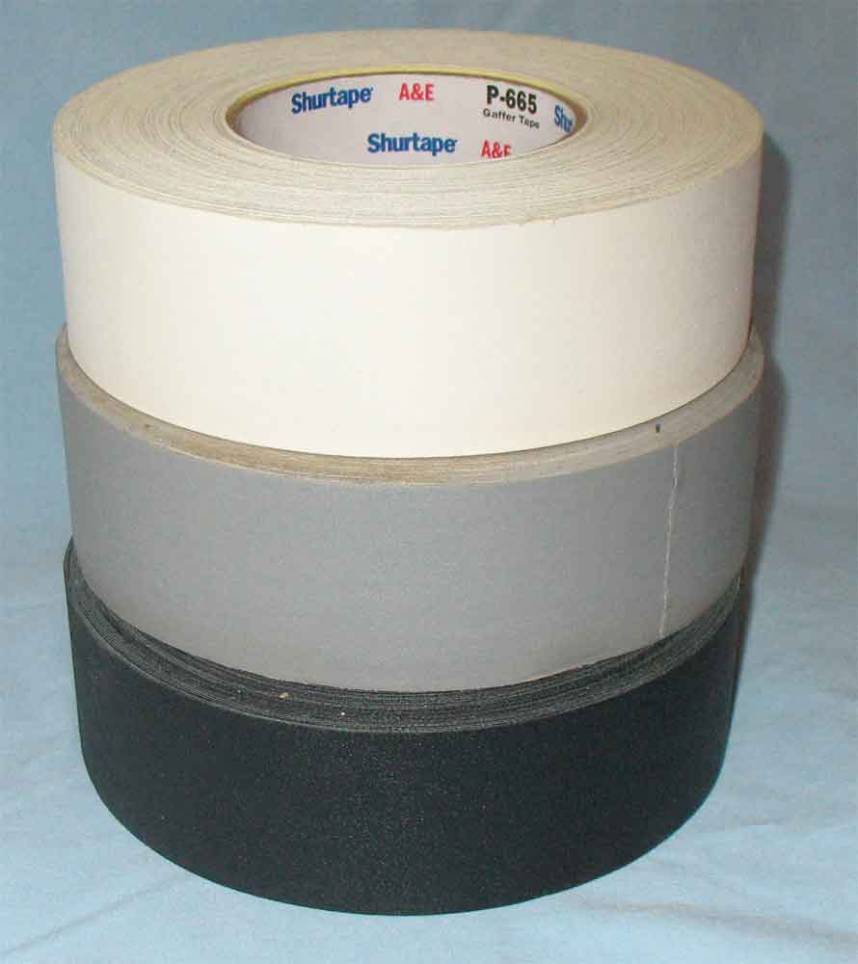
2-Inch Cloth Gaffer Tape – used for any taping need requiring tape larger than the 1-inch camera tape.

Slide 5
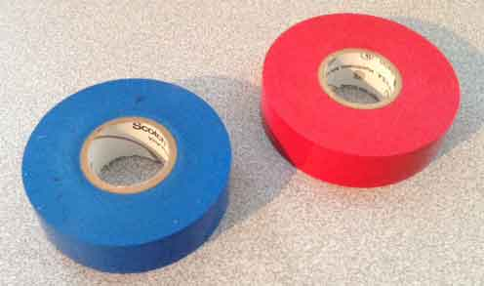
3/4-Inch Electrical Tape – used for labeling film magazines, film cans, equipment cases, etc. It is often used in place of 1-inch cloth camera tape in humid conditions where the cloth tape won’t stick.

Slide 6
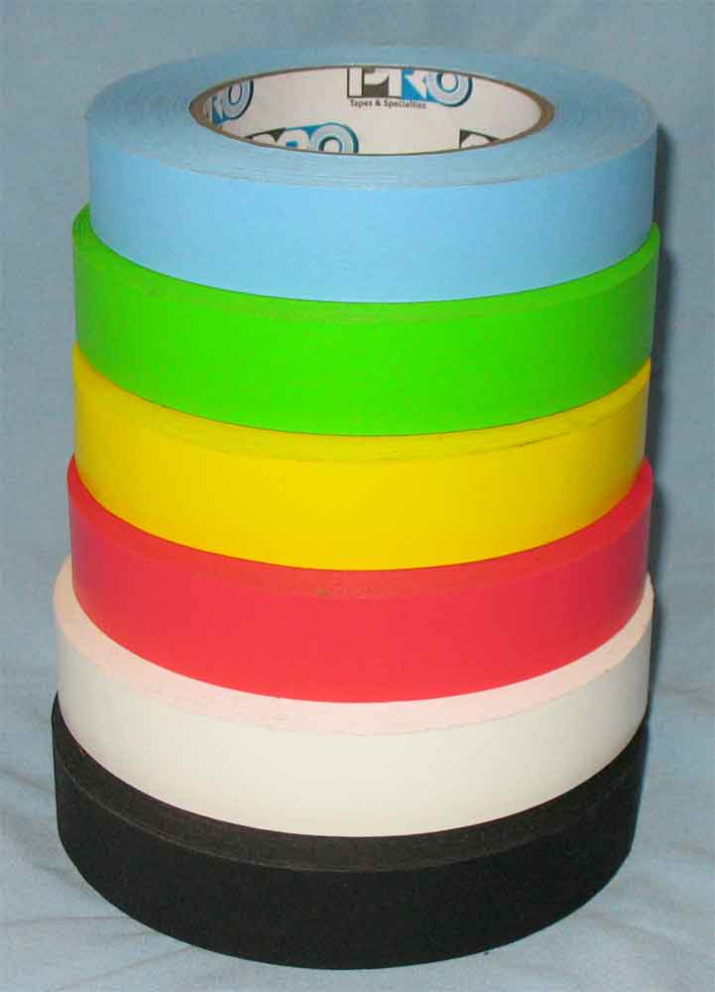
1-Inch Paper Tape – used for marking actors.

Slide 7
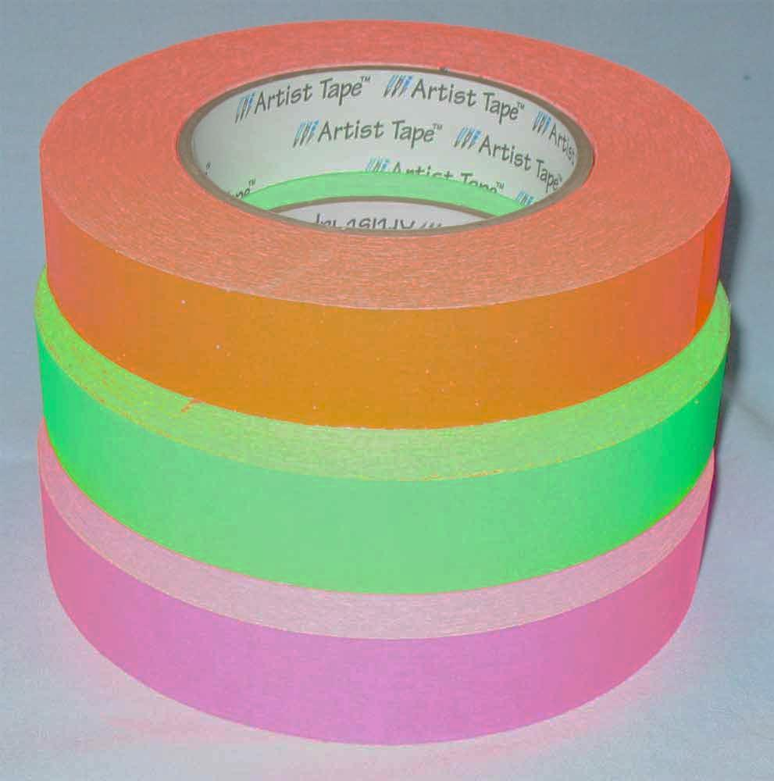
1-Inch Fluorescent Paper Tape – used for marking actors.

Slide 8
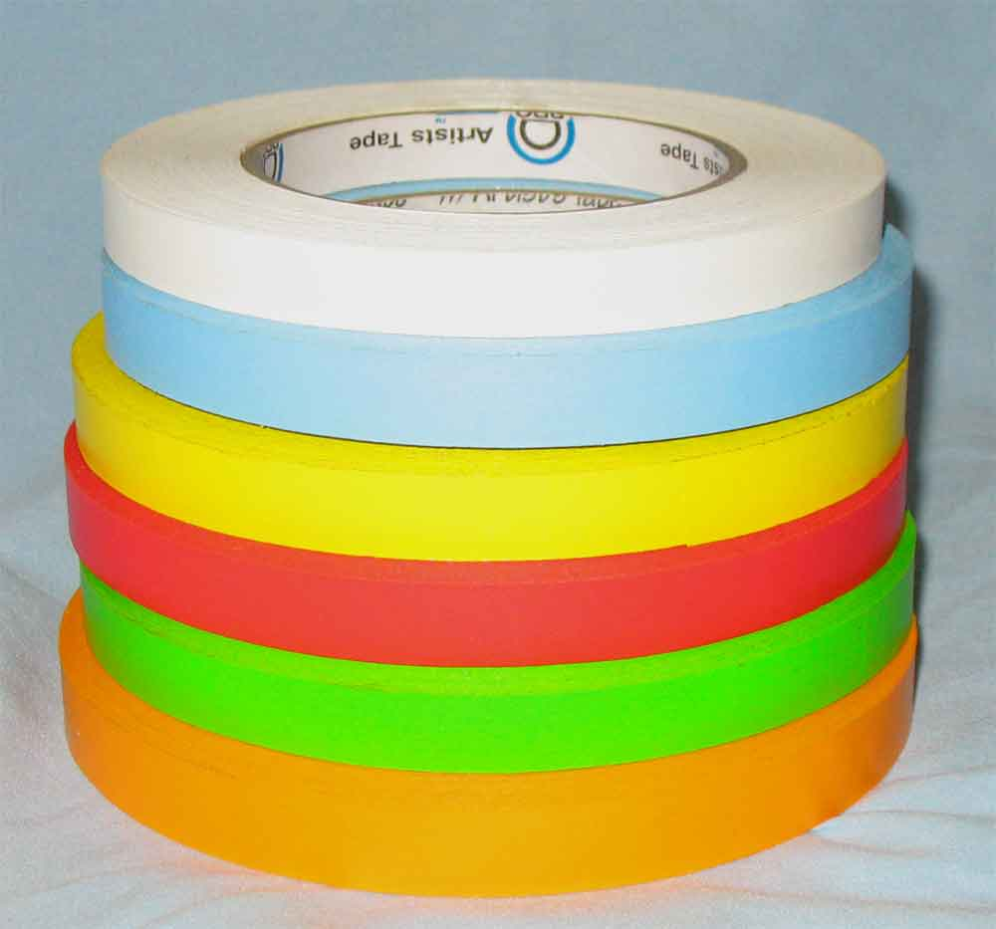
1-Inch Fluorescent Paper Tape – used for marking actors.

Slide 9
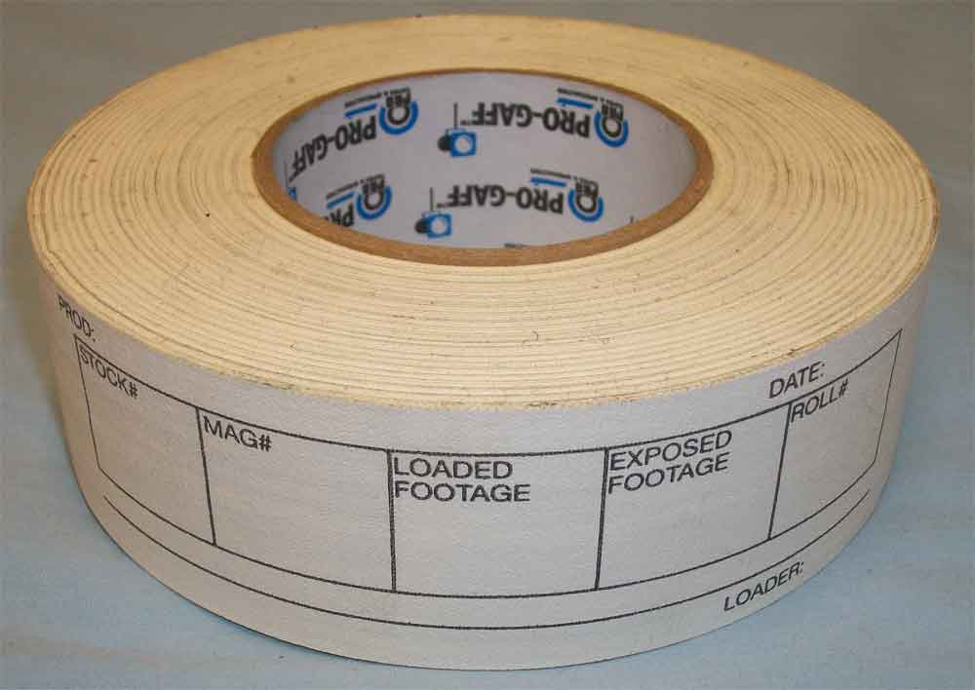
2-Inch Camera Magazine Tape – Special preprinted tape used for labeling film magazines and films cans.

Slide 10
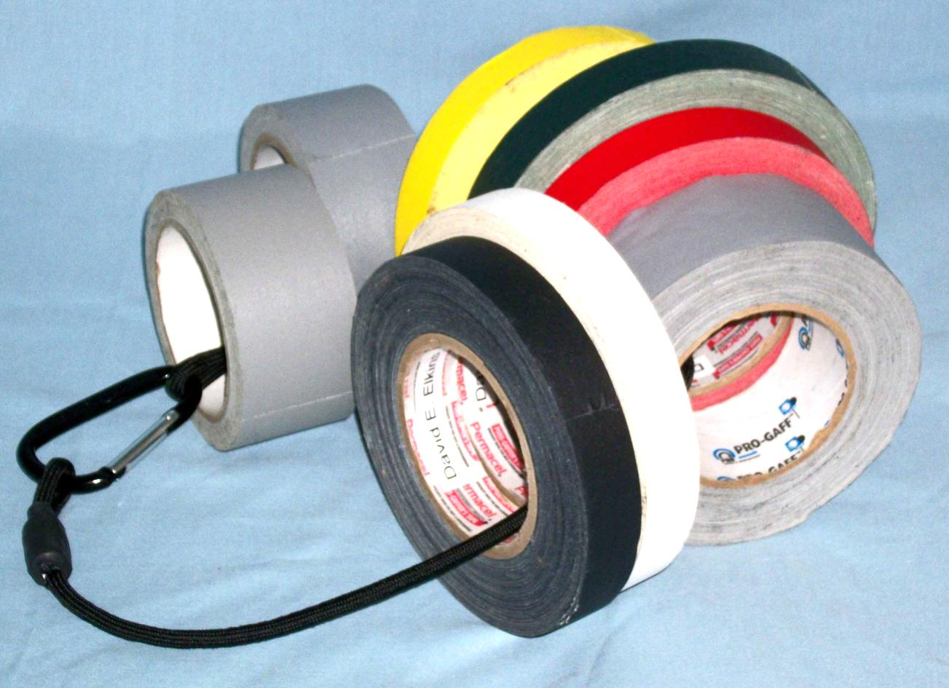
Tape Lanyard – Used to keep multiple rolls of tape together for ease of use.

Slide 11
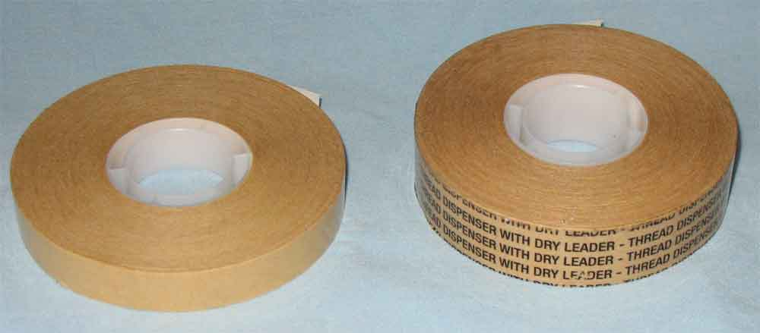
Transfer Tape (Snot Tape)– Special tape used for attaching gels or nets to the back of lenses.

Slide 12
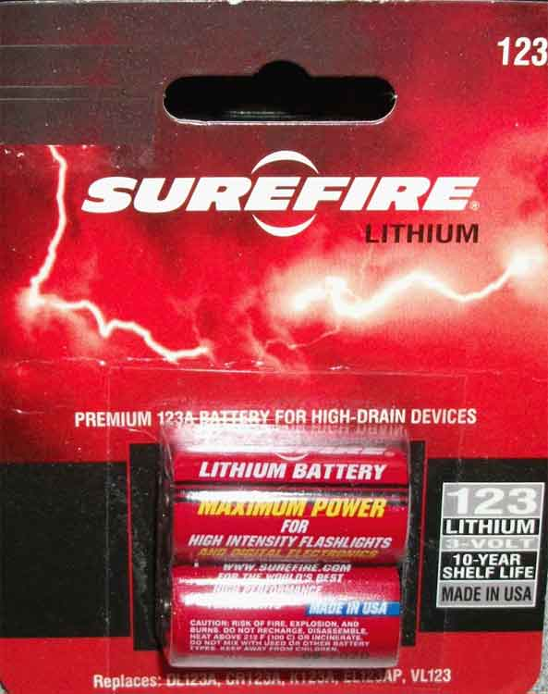
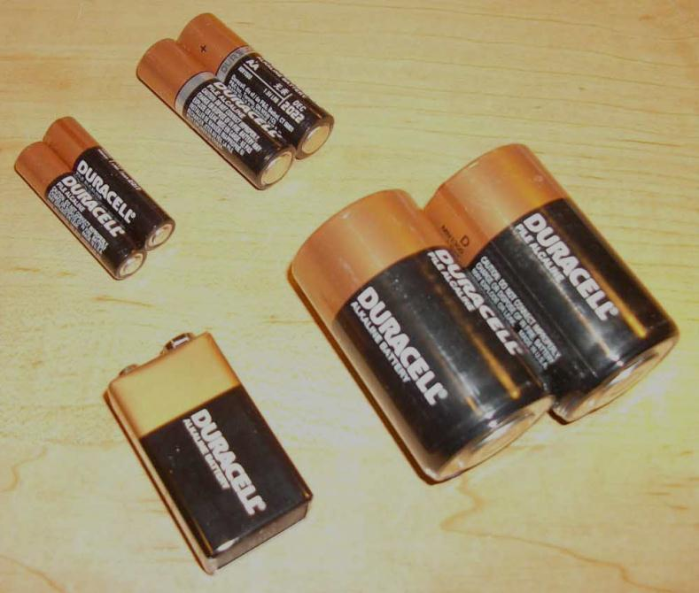
Batteries – Used to supply power to any device using batteries, such as flashlights, magnifiers, light meters, etc.

Slide 13
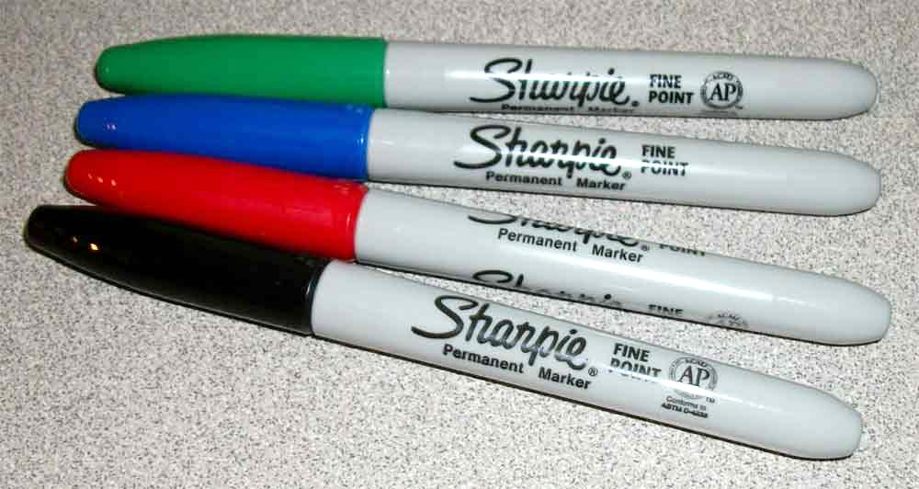
Permanent Markers – Used for writing magazine labels, film can labels and any other writing or labeling need.

Slide 14
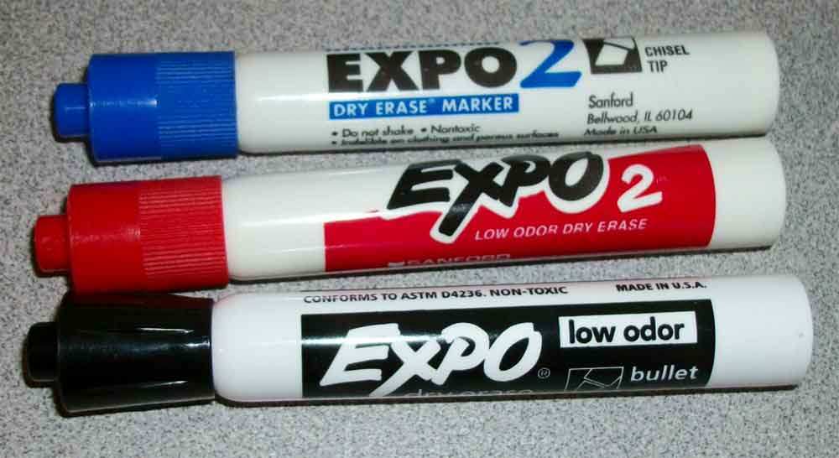
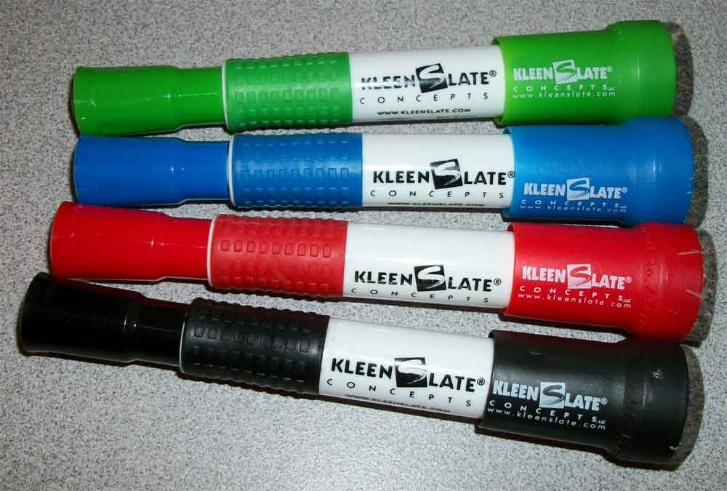
Erasable Slate Markers – Used for writing key information such as Roll, Scene & Take Numbers on the acrylic slate.

Slide 15
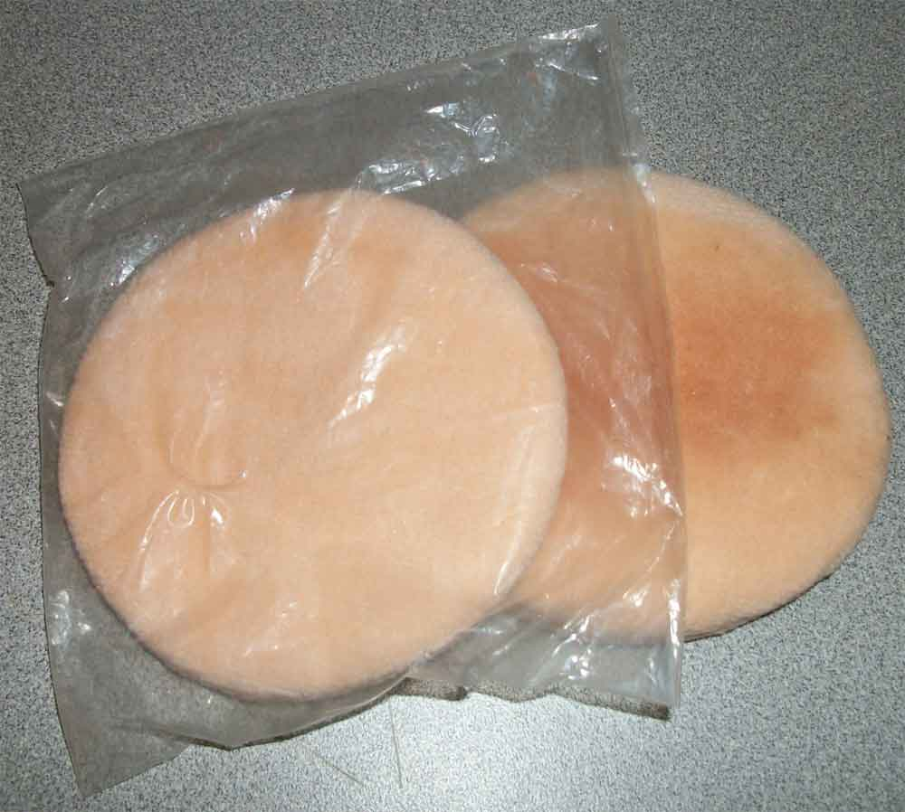
Makeup Powder Puffs – Used along with erasable slate markers to erase information from the slate.

Slide 16
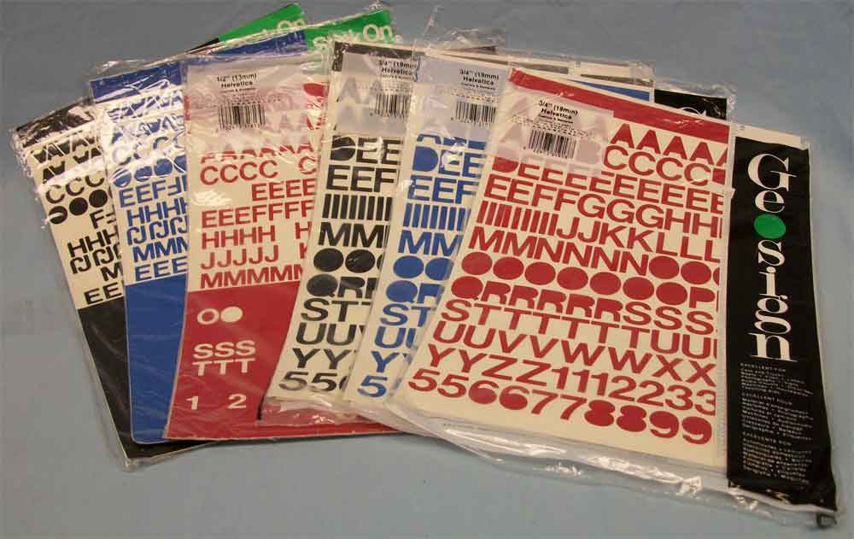
Stick on Letters – Used for labeling the slate with the pertinent production information.

Slide 17
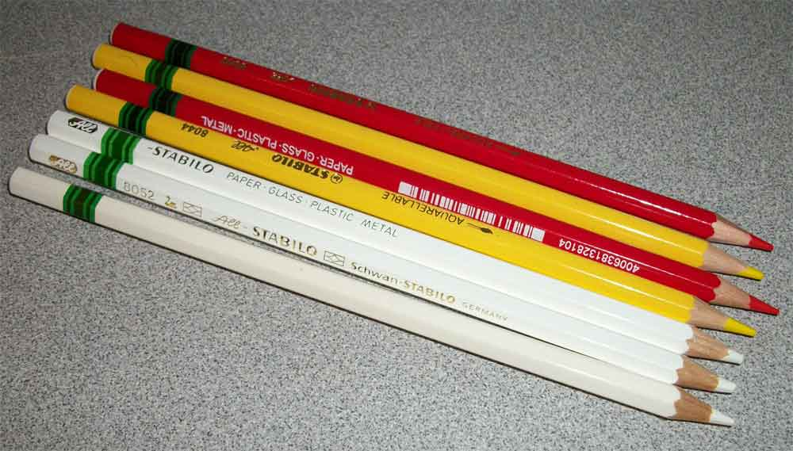
Stabilo Erasable Pencils – Used for placing focus marks on lenses or on on follow focus marking disk.

Slide 18
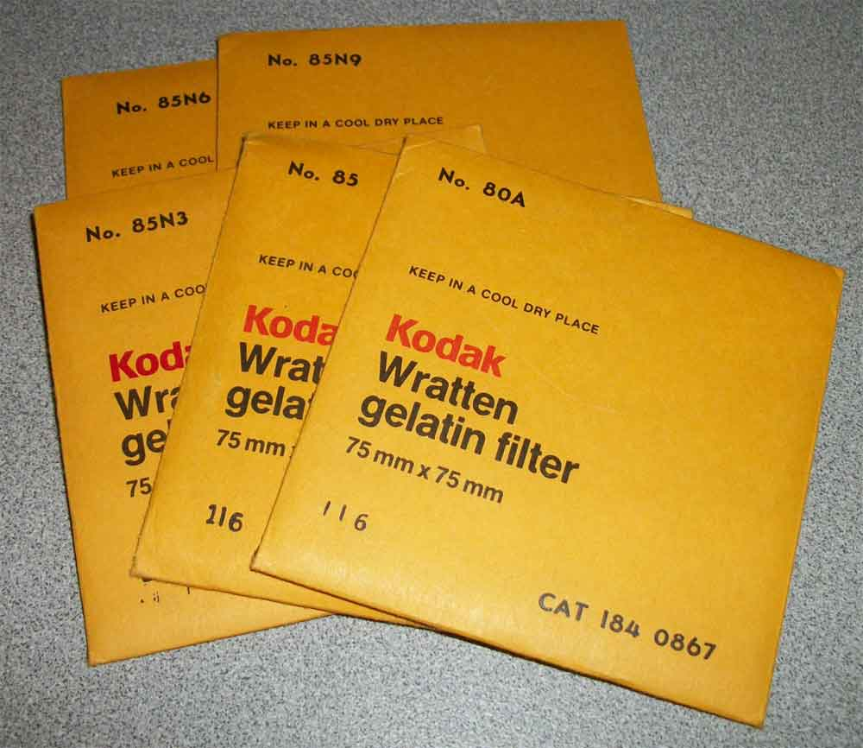
Kodak Wratten Gels – Special optically correct gel filters used for behind the lens filtration.

Slide 19
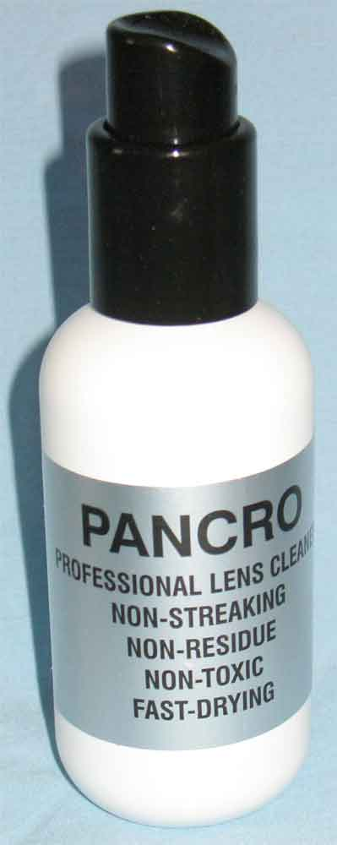
Pancro Lens Cleaner – Used along with lens tissue to clean lenses or filters.

Slide 20
Rosco Lens Cleaner & Tissue – Used for cleaning lenses and filters.

Slide 21
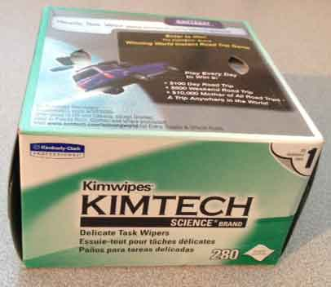
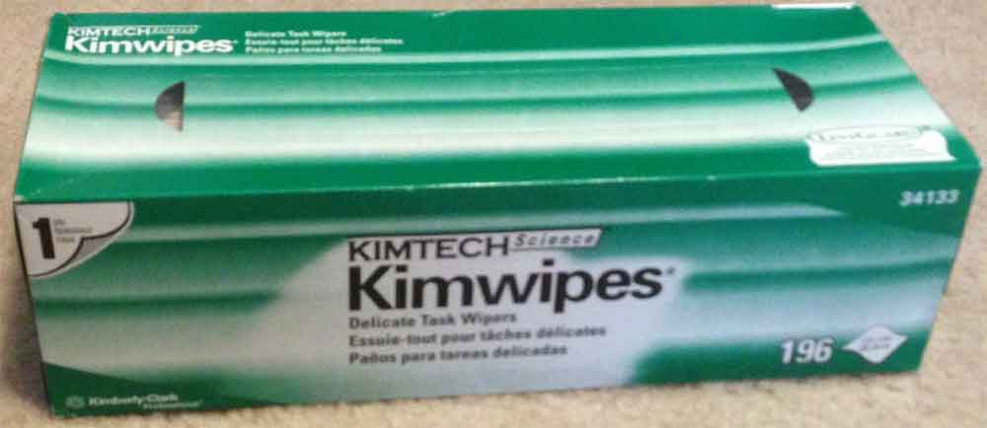
Kimwipes Tissues – Used for cleaning filters or other equipment. Not recommended for lenses.

Slide 22
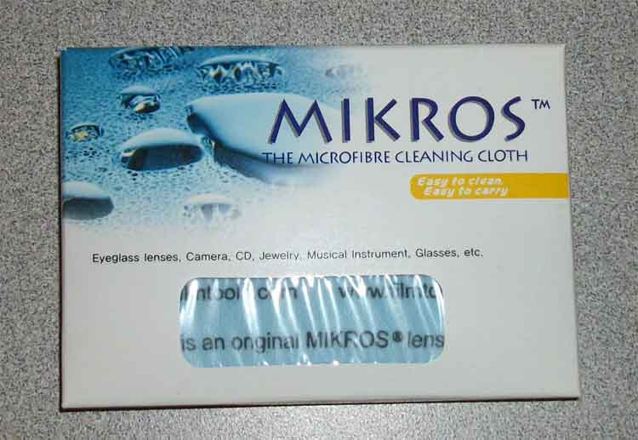
Mikros Cleaning Cloth – Microfiber cleaning cloth used for cleaning lenses and filters.

Slide 23
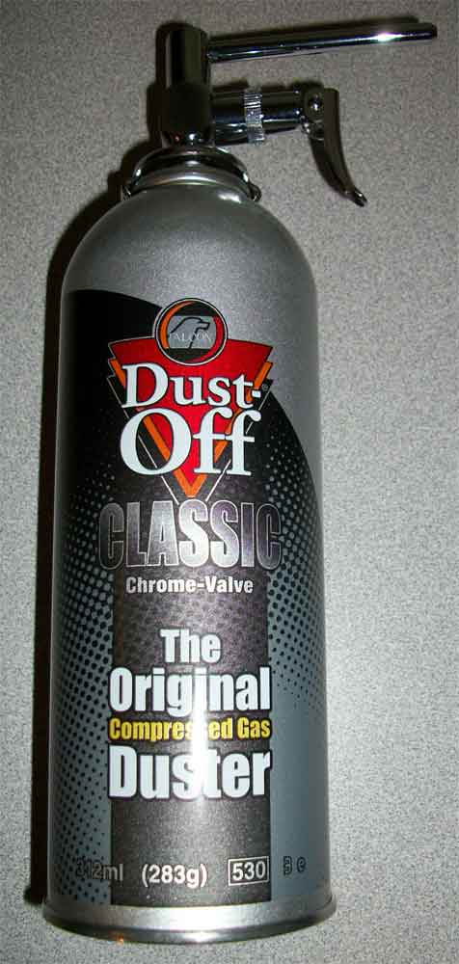
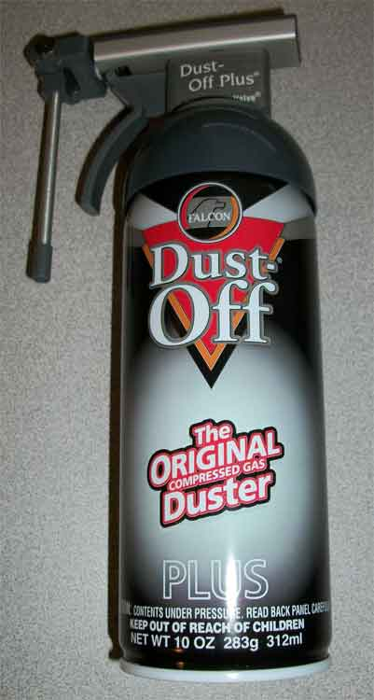
Compressed Air – Used to clean dirt/dust from lenses, filters or other camera equipment.

Slide 24
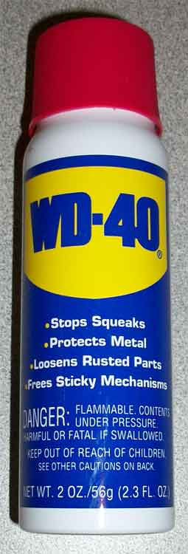
WD-40 or Silicone Spray – Use to lubricate sticky tripod legs or for any other lubrication purpose. Not to be used on the interior or exterior of any camera.

Slide 25
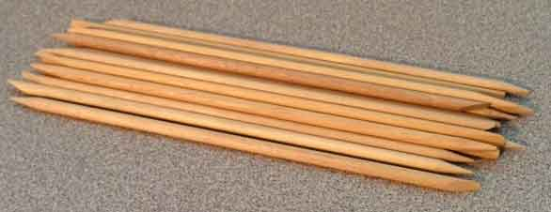
Close-up of Ends of Orangewood Sticks
Orangewood Sticks – Used to clean emulsion build-up from the gate and aperture plate.

Slide 26
Cotton Tipped Swabs (Q-Tips) – Used to clean excess oil or silicone from the camera movement and/or pull down claw.

Slide 27
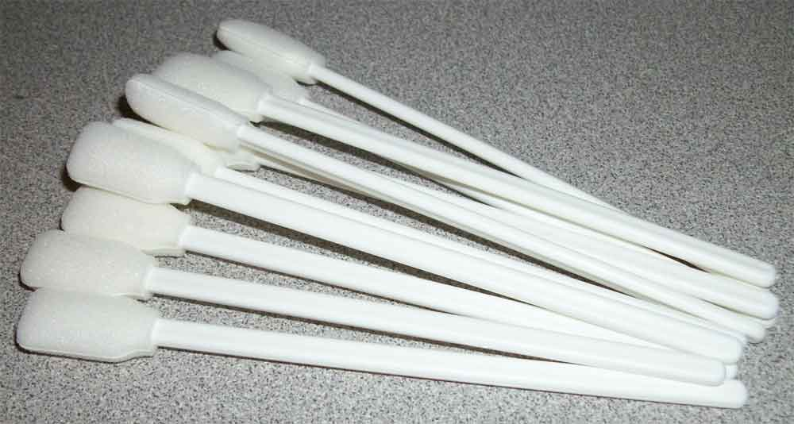
Foam Tipped Swabs – Used to clean excess oil or silicone from the camera movement and/or pull down claw. May also be used to clean the sensor on a digital camera.

Slide 28
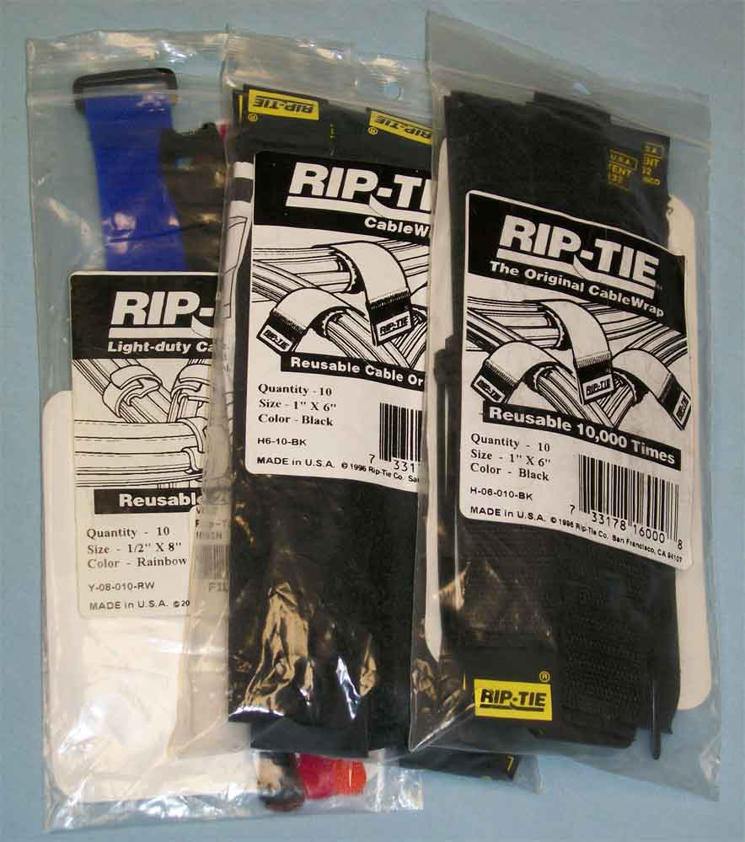
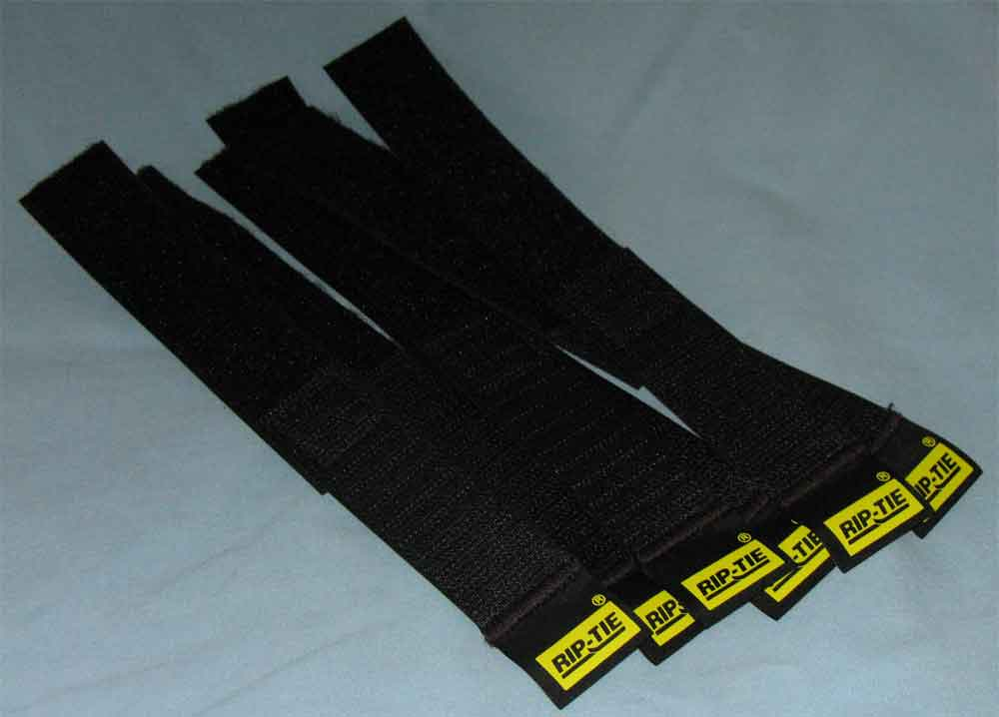
Rip-Tie Cable Ties – Used for securing cables such as power cables, video cables, etc.

Slide 29
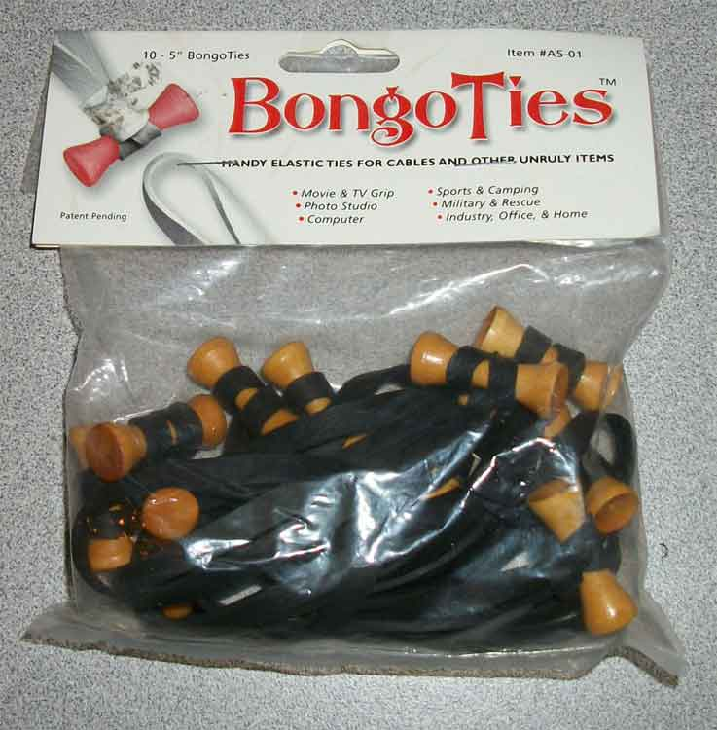
Bongo Ties – Used for securing cables such as power cables, video cables, etc.

Slide 30
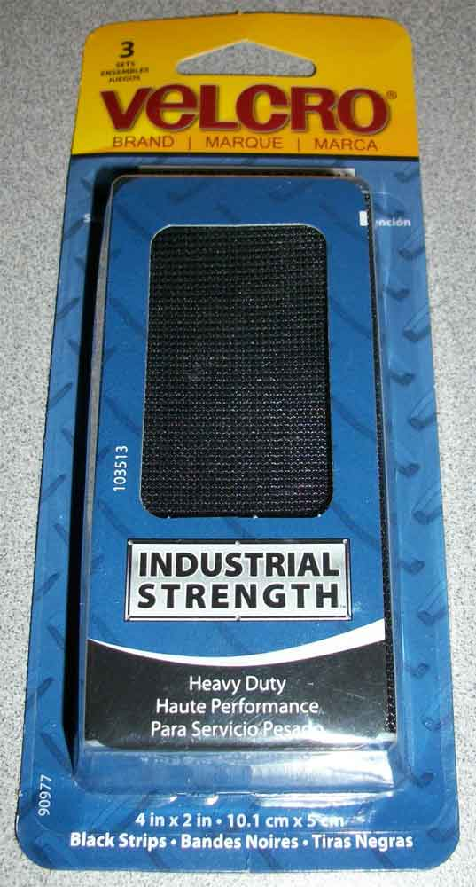
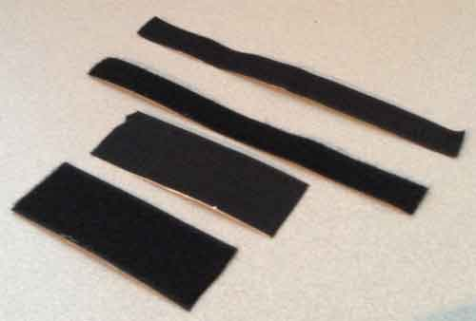
Velcro – Used to attach filter tags to matte boxes. May also be used to secure two items together.

Slide 31
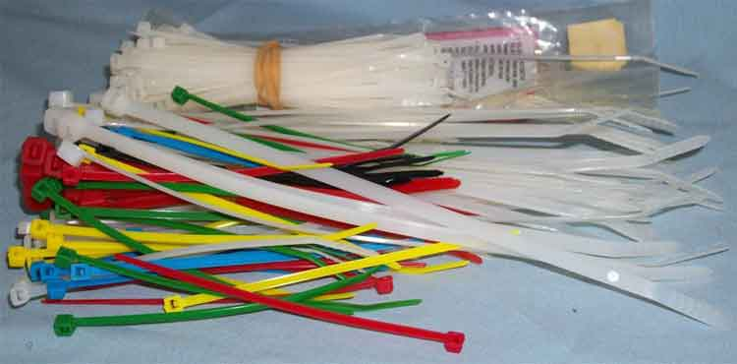
Plastic Cable Ties – Used for securing cables such as power cables, video cables, etc.

Slide 32
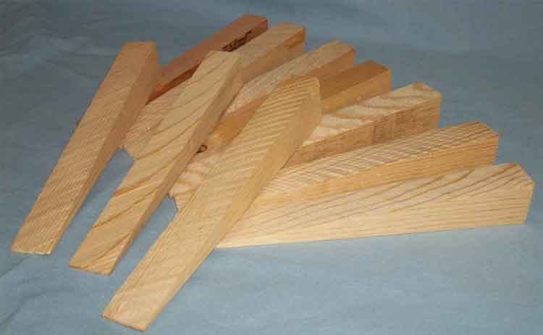
Camera Wedges – Small wooden wedges used for leveling the camera on uneven surfaces.

Slide 33
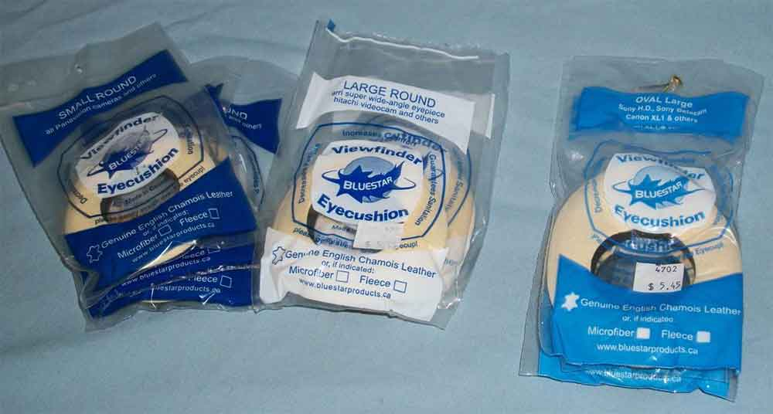
Eyepiece Chamois – Used on viewfinder eyepiece as a comfortable cushion for the Camera Operator.

Slide 34
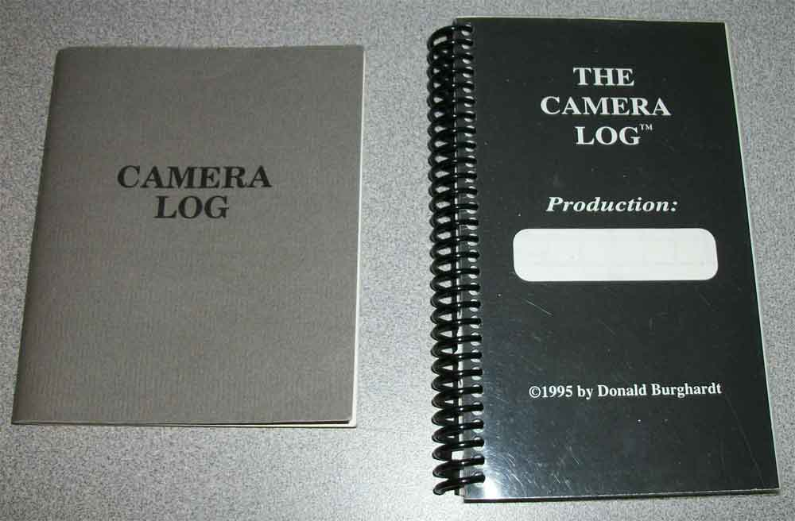
Camera Log Book – Used to record specific shot information such as lens focal length, focus distance, aperture, etc.

